Slide 1
FHIR-Based CDS
An approach to the implementation of Clinical Decision Support Use Cases using FHIR

Slide 2
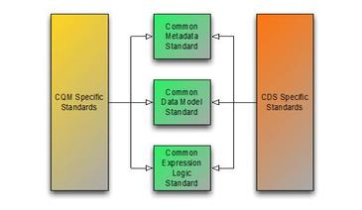
Background
Metadata – Clinical Quality Metadata Conceptual Model
Clinical Information – QUICK/QI-Core Profiles
Expression Logic – Clinical Quality Language Specification

Slide 3
Background (cont)
Effort has focused on two use cases so far:
Use Case 1 – Artifact Sharing
CDS Knowledge Artifact Specification
Clinical Quality Language
HQMF-related Specifications
Use Case 2 – Guidance Request/Response
DSS & DSS IG
Long-term we should also consider:
Use Case 3 – Knowledge Artifact Repository
DSS has specifications for this functionality

Slide 4
Use Case 2 – Current State
Interaction Protocol Defined by Decision Support Service, Release 2
Implementation Defined by Decision Support Service IG, Release 1
Component | Description
Virtual Medical Record (vMR) | Patient Information
CDSContext | Initiator, Recipient, Workflow Context
CDSInput | Container for context, patient information and params
CDSOutput | Generic container for output
CDSActionResponse | Evaluation output (CDS KAS Actions)
CDSExecutionMessage | Messages that occurred during evaluation

Slide 5
Use Case 2 – FHIR-Based
Component | FHIR Representation
Virtual Medical Record (vMR) | QI-Core Profiles
CDSContext | A new KnowledgeRequest resource (or profile of Basic)
CDSInput | Parameters resource
CDSOutput | Parameters resource
CDSActionResponse | A new KnowledgeResponse resource (or profile of Basic)
CDSExecutionMessage | OperationOutcome resource
Use the FHIR Operation framework to describe the request/response
Existing Parameters resource provides container (CDSInput/CDSOutput)
Build KnowledgeRequest and KnowledgeResponse resources

Slide 6
KnowledgeRequest Resource
Element | Type | C
requestIdentifier | Identifier | 0..1
moduleIdentifier | Identifier | 1..1
moduleVersion | String | 0..1
inputParameters | Parameters | 0..1
KnowledgeRequest specifies a request to evaluate a single module.
A knowledge module is a description of specific quality improvement functionality:
May correspond to specific artifacts:
a1C Poor Control
Chlamydia Screening Measure
May correspond to functionality
Drug-drug interaction
Diabetes Management
Immunization
Each request results in a single corresponding response

Slide 7
KnowledgeResponse Resource
Element | Type | C
responseIdentifier | Identifier | 1..1
requestIdentifier | Identifier | 0..1
moduleIdentifier | Identifier | 1..1
moduleVersion | String | 0..1
status | code | 1..1
outcome | OperationOutcome | 0..*
outputParameters | Parameters | 0..1
Each request results in a corresponding response
matching requestIdentifier (if provided as part of the request)
matching moduleIdentifier

Slide 8
GuidanceRequest Resource
Element | Type | C
initiatingOrganization | Organization | 0..1
initatingPerson | Person|Patient|Practitioner|RelatedPerson | 0..1
systemUserType | CodeableConcept | 0..1
systemUserLanguage | CodeableConcept | 0..1
systemUserTaskContext | CodeableConcept | 0..1
recievingOrganization | Organization | 0..1
receivingPerson | Person|Patient|Practitioner|RelatedPerson | 0..1
recipientType | CodeableConcept | 0..1
recipientLanguage | CodeableConcept | 0..1
encounterClass | CodeableConcept | 0..1
encounterType | CodeableConcept | 0..1
Decision Support Context – Only provided as part of a decision support request, not a measure evaluation request

Slide 9
GuidanceResponse Resource
Element | Type | C
action | Action | 0..1
action.actionId | Identifier | 0..1
action.number | String | 0..1
action.evidence | Evidence | 0..*
action.documentation | DocumentReference | 0..*
action.participant | Person|Patient|Practitioner|RelatedPerson | 0..*
action.title | String | 0..1
action.description | String | 0..1
action.concepts | CodeableConcept | 0..*
action.type | code (create | update | remove | ... ) | 0..1
action.resource | Resource | 0..1
action.actions | Action | 0..*
Decision Support Actions – Only provided as part of a decision support response, not a measure evaluation response.

Slide 10
FHIR “evaluate” Operation
An OperationDefinition named “evaluate” with the following parameters:
Name | Use | Type | C
request | in | KnowledgeRequest | 1..*
inputResource | in | Resource | 0..*
response | out | KnowledgeResponse | 1..*
outputResource | out | Resource | 0..*
Example invocation URL (FHIR operation pseudo-syntax):
[POST] [base]/$evaluate
Body of the post and the response are both Parameters
Input resources are optional, only need be provided if the FHIR service does not have the required patient/population data
Same input resources can be used by multiple knowledge requests

Slide 11
FHIR-Based DSS IG Profile
Use the same encoding as the Operation
New Semantic Signifiers for
GuidanceRequest – Payload is the same as the body of the POST (Parameters resource containing requests and input resources)
GuidanceResponse – Payload is the same as the body of the response to the POST (Parameters resource containing responses and output resources)

Slide 12
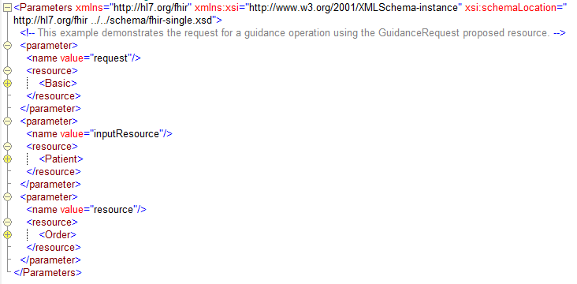
Evaluate Operation Example

Slide 13
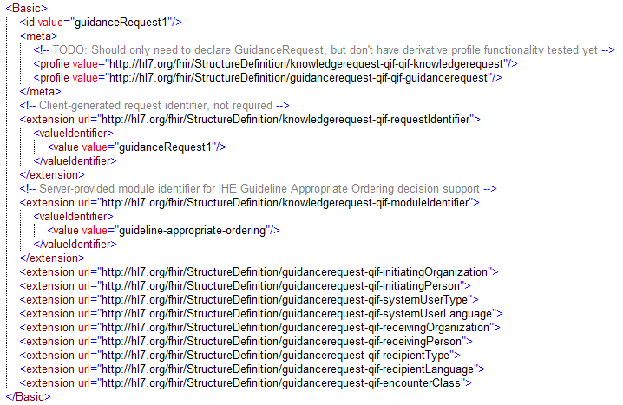
Evaluate Operation Example

Slide 14
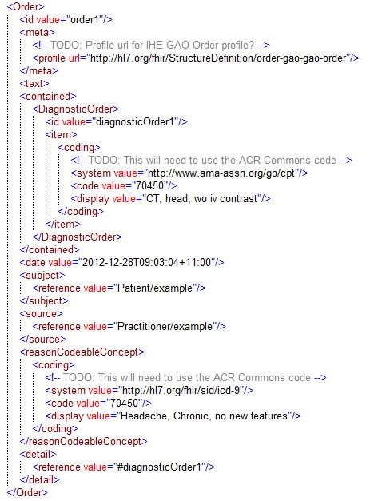
Evaluate Operation Example

Slide 15
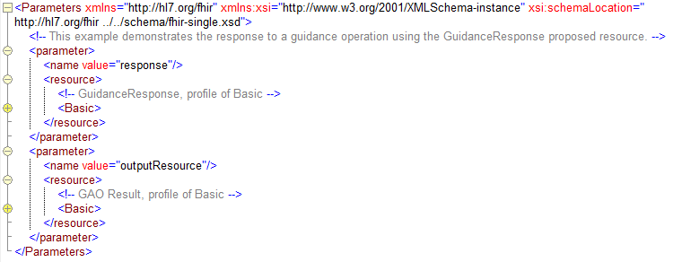
Evaluate Operation Example

Slide 16
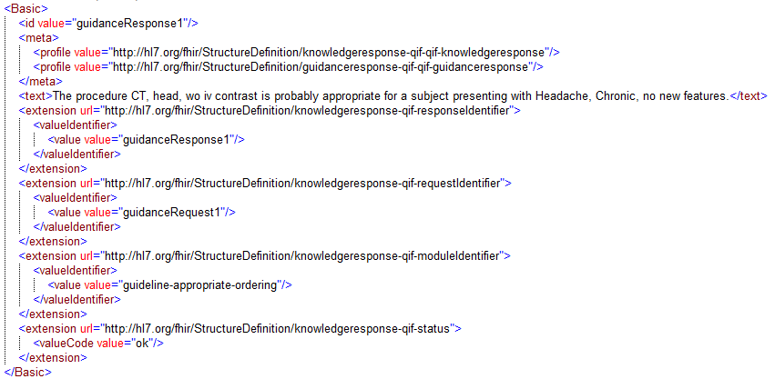
Evaluate Operation Example

Slide 17
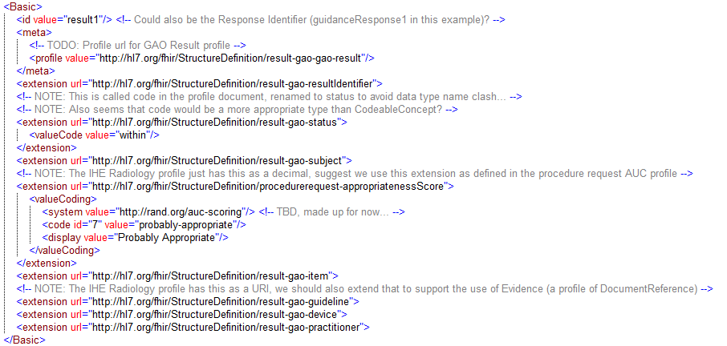
Evaluate Operation Example

Slide 18
Use Case 1 – Current State
CDS Knowledge Artifact Specification, DSTU 3
Overlap exists with Use Case 2
Metadata (Organizations, Persons, Evidence)
Actions
Introduction of CQL in DSTU3 causes impedance mismatch w/ V3 Data Types
Not insurmountable (because CQL types are abstract)
Requires mapping (i.e. CD – Code – CodeableConcept)

Slide 19
Use Case 1 – Short Term
Using the resources described above, the short-term strategy can rely on mapping
V3 Types – CQL Abstract Types
CDS KAS Actions – KnowledgeResponse.Action
Evidence (profile of DocumentReference)
This expression is currently incomplete
Only deals with Create/Update/Remove actions
Need a story for OrderSets and Documentation Templates

Slide 20
Use Case 1 – Long Term
Establish a KnowledgeModule resource (or profile of Basic)
Metadata attributes informed by the Metadata Conceptual Model
Expression Logic represented by CQL
Profiles to describe
Clinical Quality Measures
Decision Support Artifacts
Possibly different profiles for different artifact types?

Slide 21
KnowledgeModule
Element | Type | C
moduleIdentifier | Identifier | 0..*
moduleVersion | String | 0..1
type | Code | 0..1
title | string | 0..1
description | string | 0..1
purpose | string | 0..1
usage | string | 0..1
publicationDate | dateTime | 0..1
lastReviewDate | dateTime | 0..1
effectivePeriod | Period | 0..1
status | code | 0..1
model | Element | 0..*
model.name | string | 1..1
model.identifier | Identifier | 1..1
model.version | string | 0..1

Slide 22
KnowledgeModule (cont.)
Element | Type | C
library | Element | 0..*
library.name | string | 0..1
library.identifier | Identifier | 0..1
library.version | string | 0..1
library.document | DocumentReference | 0..1
topic | CodeableConcept | 0..*
keyword | string | 0..*
contributor | Element | 0..*
contributor.type | code | 1..1
contributor.party | Person|Organization | 1..1
publisher | Organization | 0..1
steward | Organization | 0..1
rightsDeclaration | string | 0..1

Slide 23
KnowledgeModule (cont.)
Element | Type | C
relatedResource | Element | 0..*
relatedResource.type | code | 1..1
relatedResource.uri | uri | 0..1
relatedResource.description | string | 0..1
relatedResource.document | DocumentReference|Evidence | 0..1
parameter | Element | 0..*
parameter.name | string | 1..1
parameter.use | code | 1..1
parameter.documentation | string | 0..1
parameter.type | code | 1..1
parameter.profile | StructureDefinition | 0..1

Slide 24
Use Case 3 – DSS Long Term
Use Case 2 is only the most basic interface described by the DSS specification
Other interfaces include
Repository functionality
Data Requirements Definition

Slide 25
Use Case 3 – Long Term (cont)
CDSInputSpecification
Defines data requirements for knowledge artifacts
KnowledgeModule
Profile of Basic
Metadata, Models, Libraries, Expressions
Parameters, Data Requirements
CDSOutputSpecification
Defines output structures of knowledge artifacts
Also specified with the KnowledgeModule structures, specifically Parameters.

Slide 26
Data Requirements
Add the following elements to the KnowledgeModule profile:
Element | Type | C
data | Element | 0..*
data.type | OperationParameterType | 0..1
data.profile | Reference(StructureDefinition) | 0..*
data.codeFilter | inline-element | 0..*
data.codeFilter.path | string | 1..1
data.codeFilter.valueSet | ValueSet | 1..1
data.dateFilter | inline-element | 0..*
data.dateFilter.path | string | 1..1
data.dateFilter.period | Period | 1..1

Slide 27
FHIR “knowledgeRequirements” Operation
An OperationDefinition named “knowledgeRequirements” with the following parameters:
Name | Use | Type | C
moduleIdentifier | in | Identifier | 0..*
result | out | KnowledgeModule | 1..1
Example invocation URL (FHIR operation pseudo-syntax):
[POST] [base]/$knowledgeRequirements
Body of the post is a Parameters resource with the parameters of the operation
Response is a KnowledgeModule resource

Slide 28
Advantages of Proposed Approach
Consistent with native-FHIR operations
Allows synchronous and asynchronous calls via a FHIR service
Establishes patterns for native-FHIR expression of Metadata and Actions
Enables FHIR-based DSS IG profile as well
Use the same resources (Parameters, KnowledgeRequest/Response)
Allows existing DSS-based infrastructure to use the same approach
Resolves Impedance mismatch (due to KAS R3)
Separates definition/instance in Actions

Slide 29
Disadvantages
Requires mapping from CDS KAS Actions
Actions in CDS KAS are broad and flexible
Scope of Actions thus far has been reduced to achieve implementation
Requires creation of new resources in FHIR
Worst case these could be created as profiles of Basic

Slide 30
Questions/Discussion

